Slide 1
Search algorithms

Slide 2
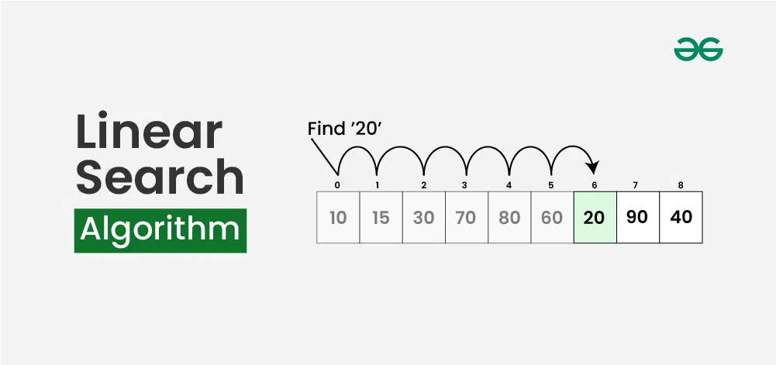
1- LINEAR SEARCH
It is count and compare element by element until you find the item your are looking for
The time complexity: O( n)

Slide 3
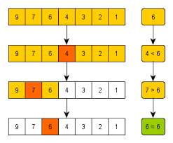
2-Binary search
It divides the list into two halves at each step. It compares the element in the halves with the value it is looking for. If it is smaller, it goes to the second halves, and if it is larger, it goes to the first halves.
Condition: The list must be sorted (ascending or descending).
Time complexity: O(log(n))

Slide 4
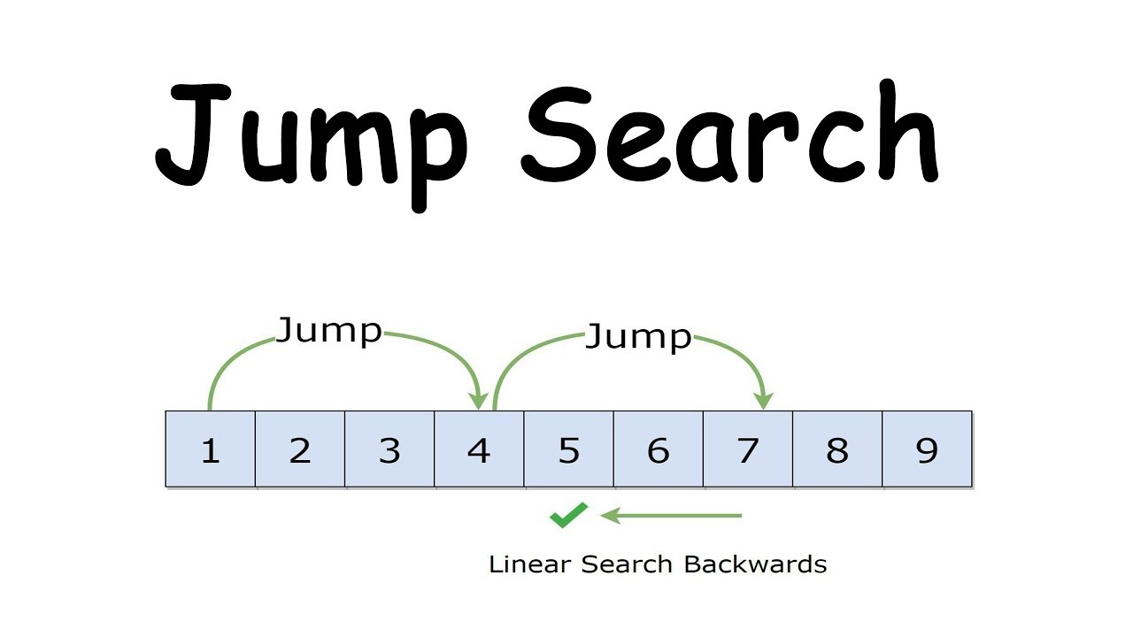
3- Jump search
It jumps in steady steps (for example, every √n element), and when it finds that the value it is searching for is less than the current element, it begins a linear search in that sector.
Condition: The list must be sorted (ascending or descending).
Time complexity: O(√n )

Slide 5
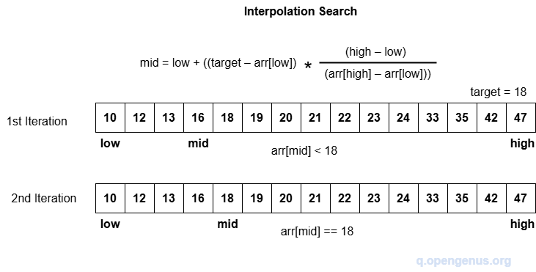
4-Interpolation search
It is an advanced search algorithm similar to binary search, but it is a little smarter because instead of dividing the list by text, it tries to estimate the location of the element you are searching for based on its value.
The data is arranged in ascending order and The data is uniformly distributed
Time complexity : O(log(log(n)))

Slide 6
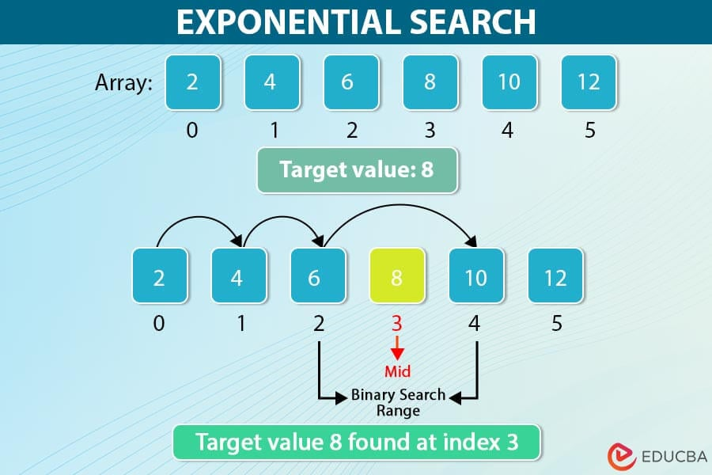
5-Exponential Search
It is algorithm that works on a sorted list. It starts by determining a suitable range for the element we are searching for using exponential steps, and then uses a binary search within this small range.
The data is sorted in ascending order.
You don't need to know the exact size of the data (such as large files or reading from a database).
When you need to search quickly and your data is very large.
Time complexity : O(log(i))

Slide 7
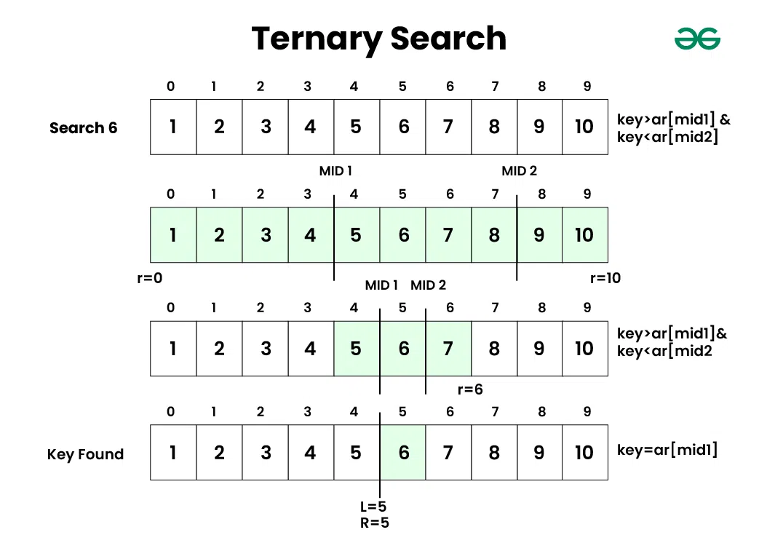
6-Ternary Search
It is an algorithm similar to binary search, but instead of dividing the list into two halves, it divides it into three approximately equal parts, and focuses in each step on only one part according to the target value.
Time complexity : O(log(n))

Slide 8
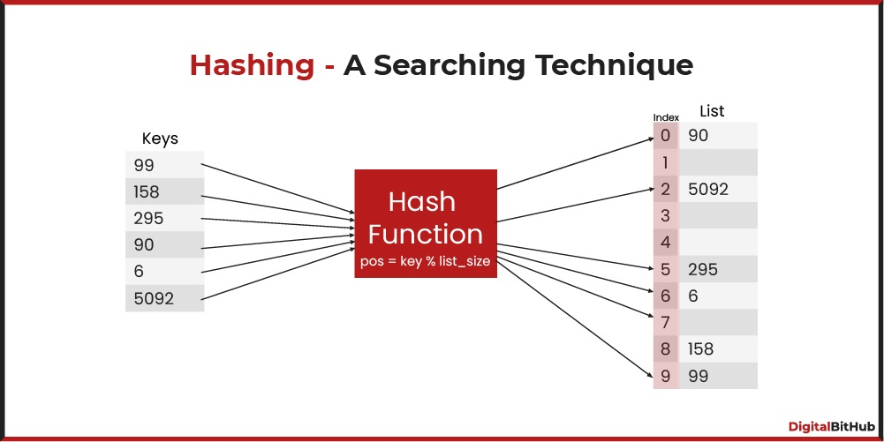
7- Hash based search
It is a method of storing data in an intelligent way so that we can access any element in it at a very high speed, often in a constant time of O(1) on average.

Slide 9
Comparison: complexity.DS
Operation | Array | Linkedlist | Stack | Queue
Access | O(i) | O(n) | O(n) | O(n)
Search | O(n) | O(n) | O(n) | O(n)
Inset @ end | O(n)or O(1) | O(1) | O(1) | O(1)
Inset @ Beginning | O(n) | O(1) | O(n) | O(n)
Delete @ end | O(n) | O(1) | O(1) | O(n)
Delete @ Beginning | O(n) | O(1) | O(n) | O(1)
Space complexity | O(n) | O(n) | O(1) | O(n)

